Slide 1
NERO ROLL CALL
Miramar Beach, FL
NERO Board: 3/2/2025

Slide 2
States completing Roll Call
18 states completing survey
North Carolina Arizona Arkansas
Minnesota Indiana Florida
Oregon Virginia Maine California Michigan Colorado
Pennsylvania Delaware Mississippi
Wisconsin Iowa South Dakota

Slide 3
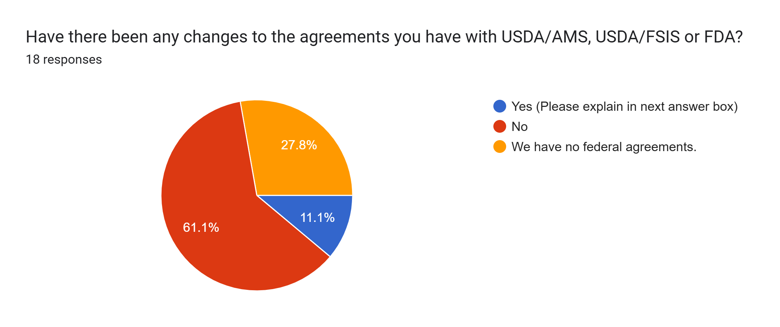
Arkansas, Maine

Slide 4
Maine
We no longer have a USDA plant in Maine. Hillandale Farms Conn., LLC has closed. I am still doing surveillance for a farm with less than 3000 birds. We do have an agreement signed for 2025.

Slide 5
Number of people working in Egg Inspection program
 | Egg Inspectors | Supervisory | Administrative
Michigan | 5 | 1 | 0
Arkansas | 8 | 3 | 1
Maine | 0 | 0 | 1
South Dakota | 0.25 | 0.25 | 0.25
Pennsylvania | 5 | 1 | 1
Arizona | 6 state program 11 USDA cooperative program | 1 state 2 USDA cooperative program | 1.2
Minnesota | 0.3 | 0.1 | 0.1
Oregon | 2 | 0.5 | 0.25
California | 14 | 4 | 5
Delaware | 2 | 1 | 1
Virginia | 2 | 2 | 1
Colorado | 2 | 1 | 0.5
North Carolina | 1 | 2 | 3
Florida | Zero. Inspections at egg processors are wrapped into our manufactured food program. | Zero however there are 5 supervisors in the manufactured food program. | 0
Wisconsin | 2 | 1 | 0
Indiana | 4.5 | 0.5 | 2
Mississippi | Licensing, Labeling, and Egg Marketing Law 10 | Licensing, Labeling, and Egg Marketing Law 2 | Licensing, Labeling, and Egg Marketing Law 2
Iowa | 2 | 2 | 2

Slide 6
Inspection frequency Producers, Wholesalers, Retailers,
Spreadsheet – by state

Slide 7
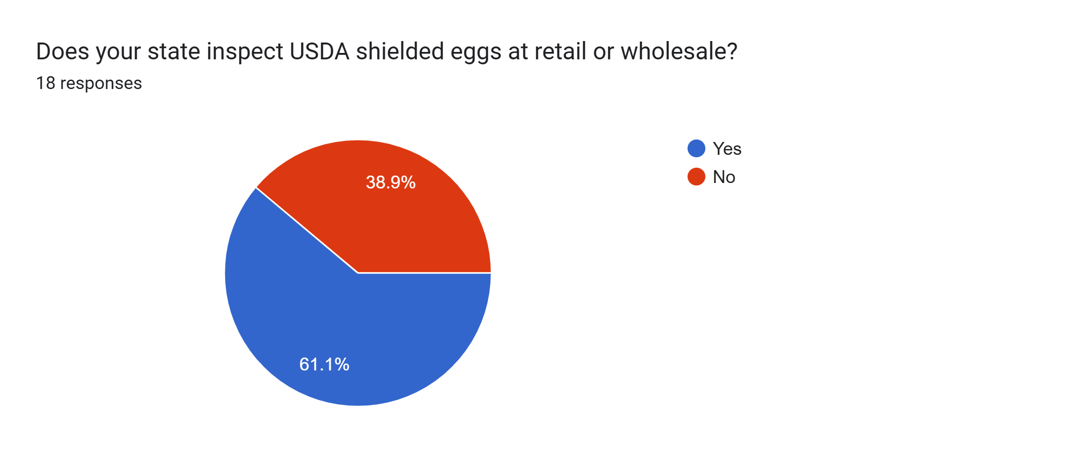

Slide 8
Do you Inspect Shielded Eggs
NO
Michigan, Maine, Pennsylvania, Minnesota, Virginia, North Carolina, Iowa
Yes
Arkansas, South Dakota, Arizona, Oregon, California, Deleware, Colorado, Florida, Wisconsin, Indiana, Mississippi

Slide 9
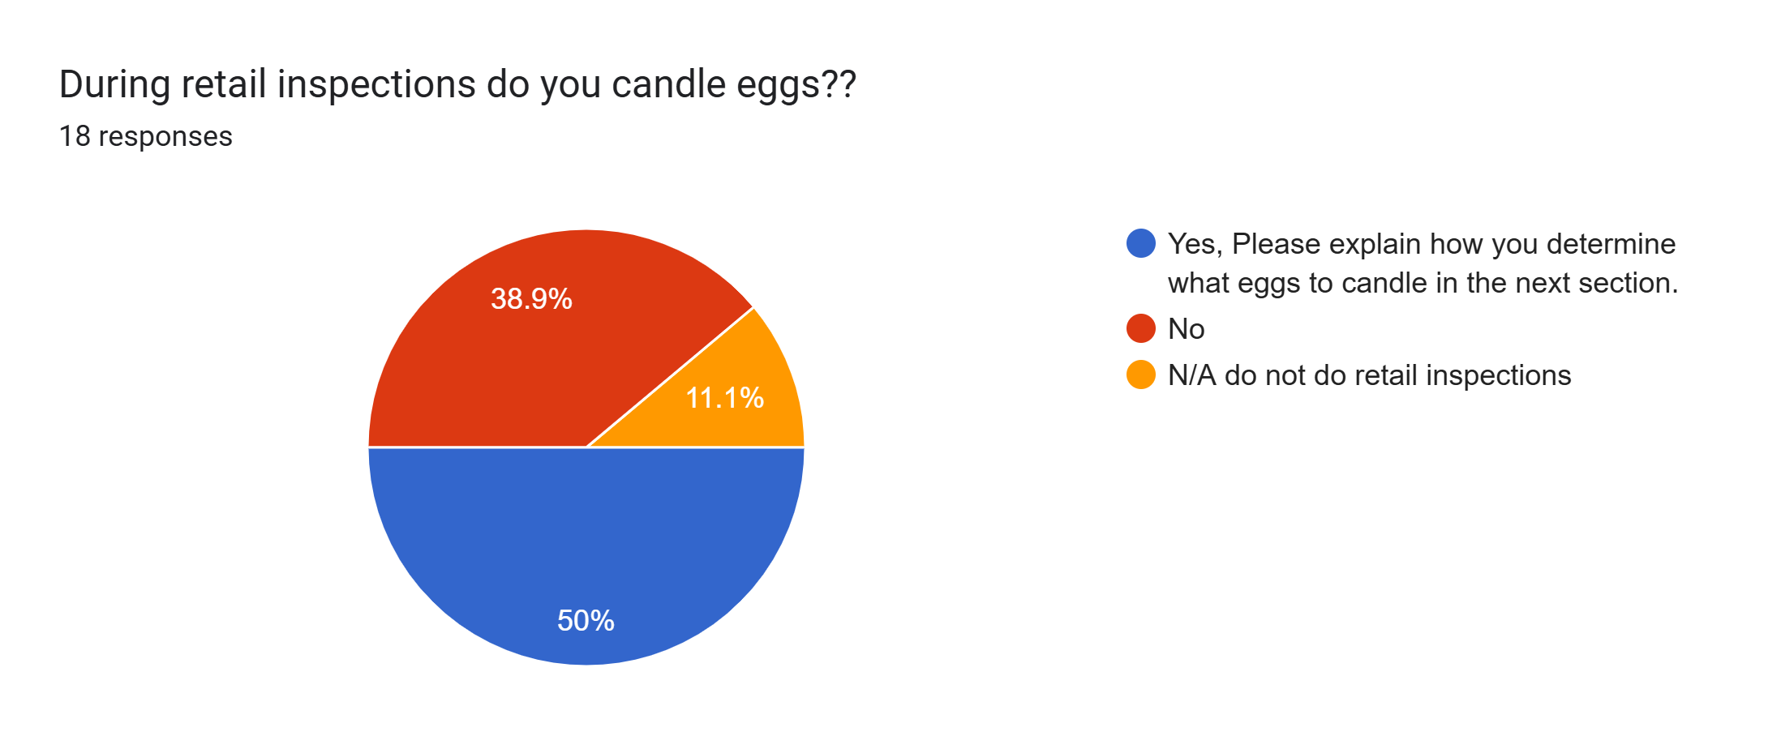

Slide 10
Who Candles at Retail? Explain Sampling
Arkansas
South Dakota
Pennsylvania
Arizona
Oregon
Delaware
Colorado
Wisconsin
Indiana

Slide 11
Who Candles at Wholesale? Explain Sampling
Arkansas
Pennsylvania
Arizona
Minnesota
Oregon
California
Wisconsin
Indiana

Slide 12
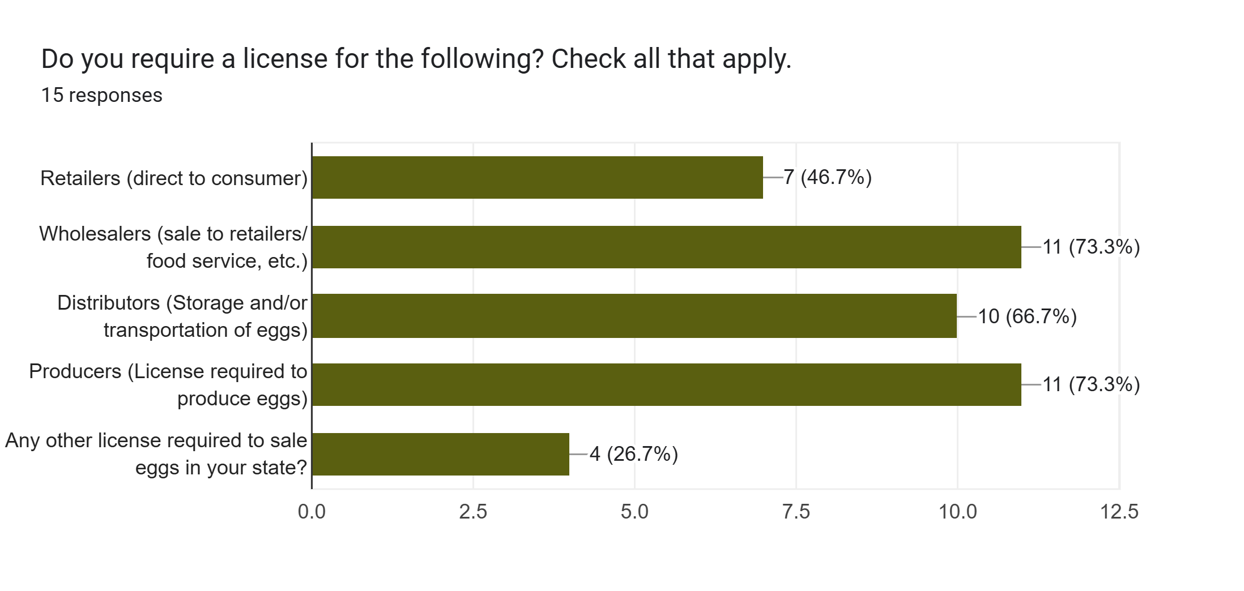

Slide 13
State Licensing requirements/fees
Summary Sheet

Slide 14
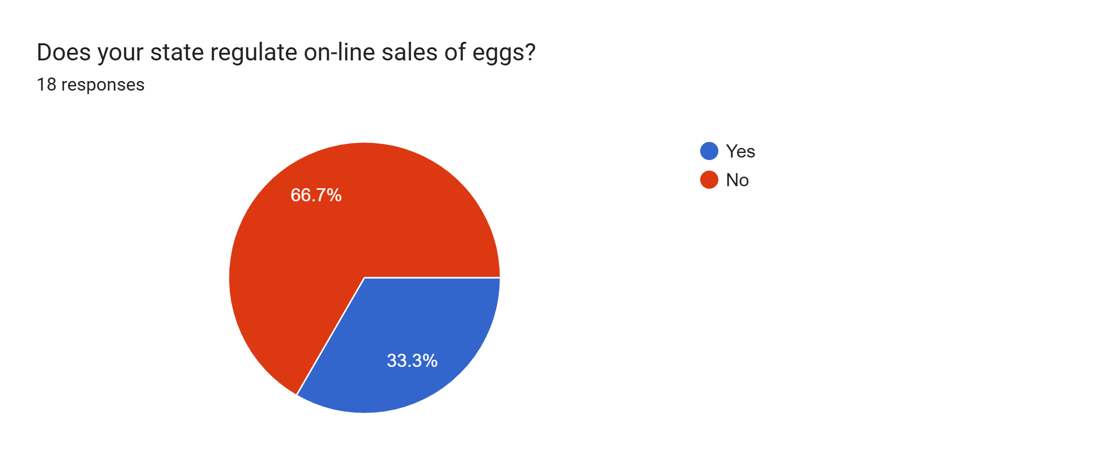
Arkansas, Pennsylvania, Arizona, California, Florida, Indiana

Slide 15
How do you regulate On-Line sales? Requirements and Enforcement
Arkansas
Pennsylvania
Arizona
California
Florida
Indiana

Slide 16
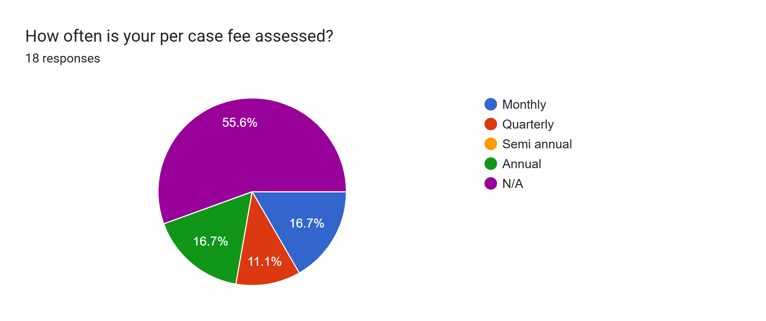

Slide 17
State Case Fee Requirements
Arkansas $.06
Arizona $.09
Oregon $.08
California $.10
Indiana $.11
Mississippi $.20

Slide 18
State Case Fee Requirements
Minnesota
HIGHEST VOLUME OF CASES EACH LICENSING YEAR FEE 1 - 50 $ 12.50 51 - 100 $ 31.25 101 - 1000 $ 62.50 1001 - 2000 $ 93.75 2001 - 4000 $125.00 4001 - 6000 $156.25 6001 - 8000 $187.50 8001 - 10,000 $250.00 OVER 10,000 $312.0
Pennsylvania
Only facilities enrolled in our voluntary PA Certified Program are assessed a per case fee. WHOLESALE LOTS (MONTHLY VOLUME) 0—2,000 cases $ 3 per month 2,001—7,000 cases 7 per month 7,001—10,000 cases 10 per month 10,001—20,000 cases 12 per month 20,001—40,000 cases 14 per month 40,001—and over cases 15 per month CONSUMER LOTS (MONTHLY VOLUME) 0—250 cases $ 15 per month 251—500 cases 20 per month 501—1,000 cases 25 per month 1,001—2,000 cases 30 per month 2,001—4,000 cases 35.00 per month. 4,001—8,000 cases 40.00 per month 8,001—16,000 cases 45 per month 16,001—or more cases 50 per month

Slide 19
State Case Fee Requirements - Other
Arkansas
Liquid/36#=casesX$0.06 per case; Dried/9#=casesX$0.06 per case; Boiled/50#=casesX$0.06 per case; Diced/50#=casesX$0.06 per case
Arizona
$0.003 per pound of egg product
California
Liquid, dry, frozen etc are still based on a 30 dozen case conversion.

Slide 20
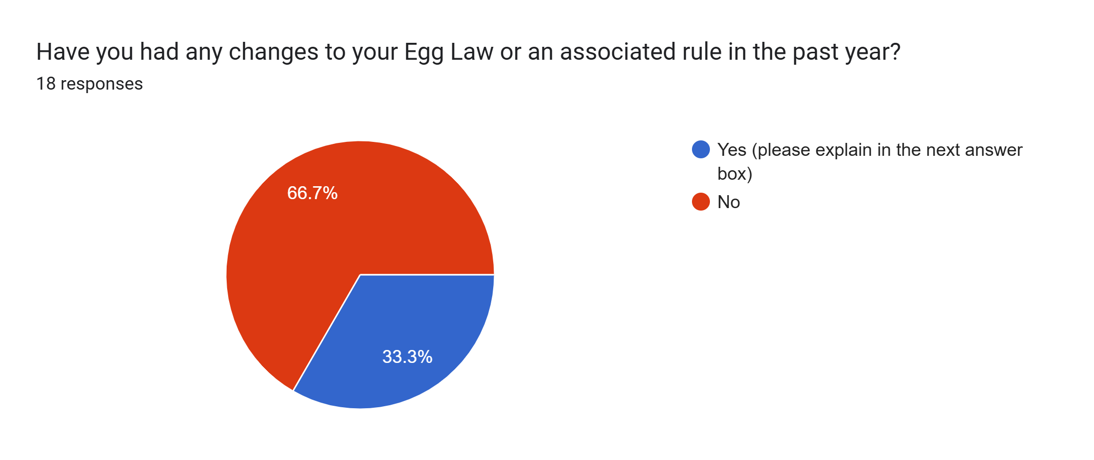
Michigan, Arkansas, Arizona, Colorado, Wisconsin, Indiana

Slide 21
Does your state allow repacking of eggs at retail?
Michigan, Oregon, Delaware, Colorado, Wisconsin, Mississippi

Slide 22
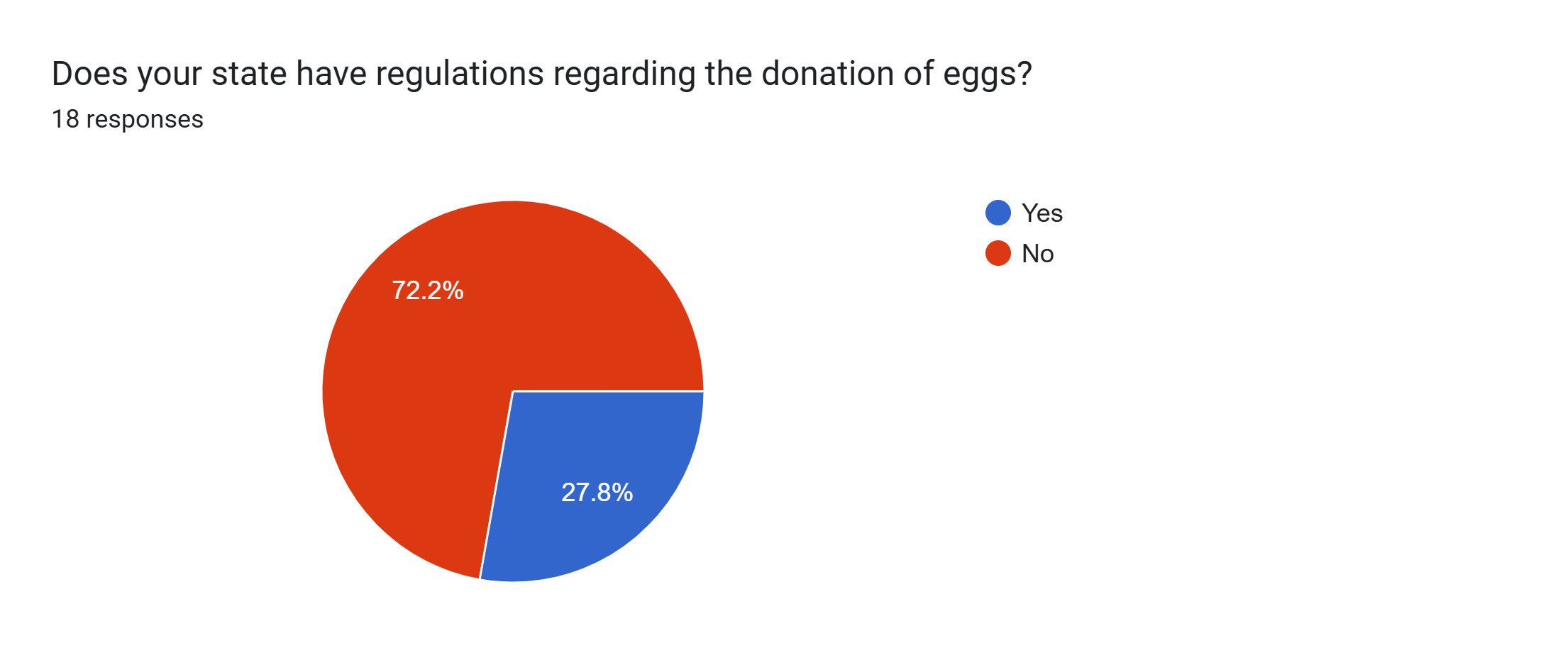
Minnesota, Arizona, Oregon, California, Indiana
Other agency’s involved? Minnesota Indiana

Slide 23
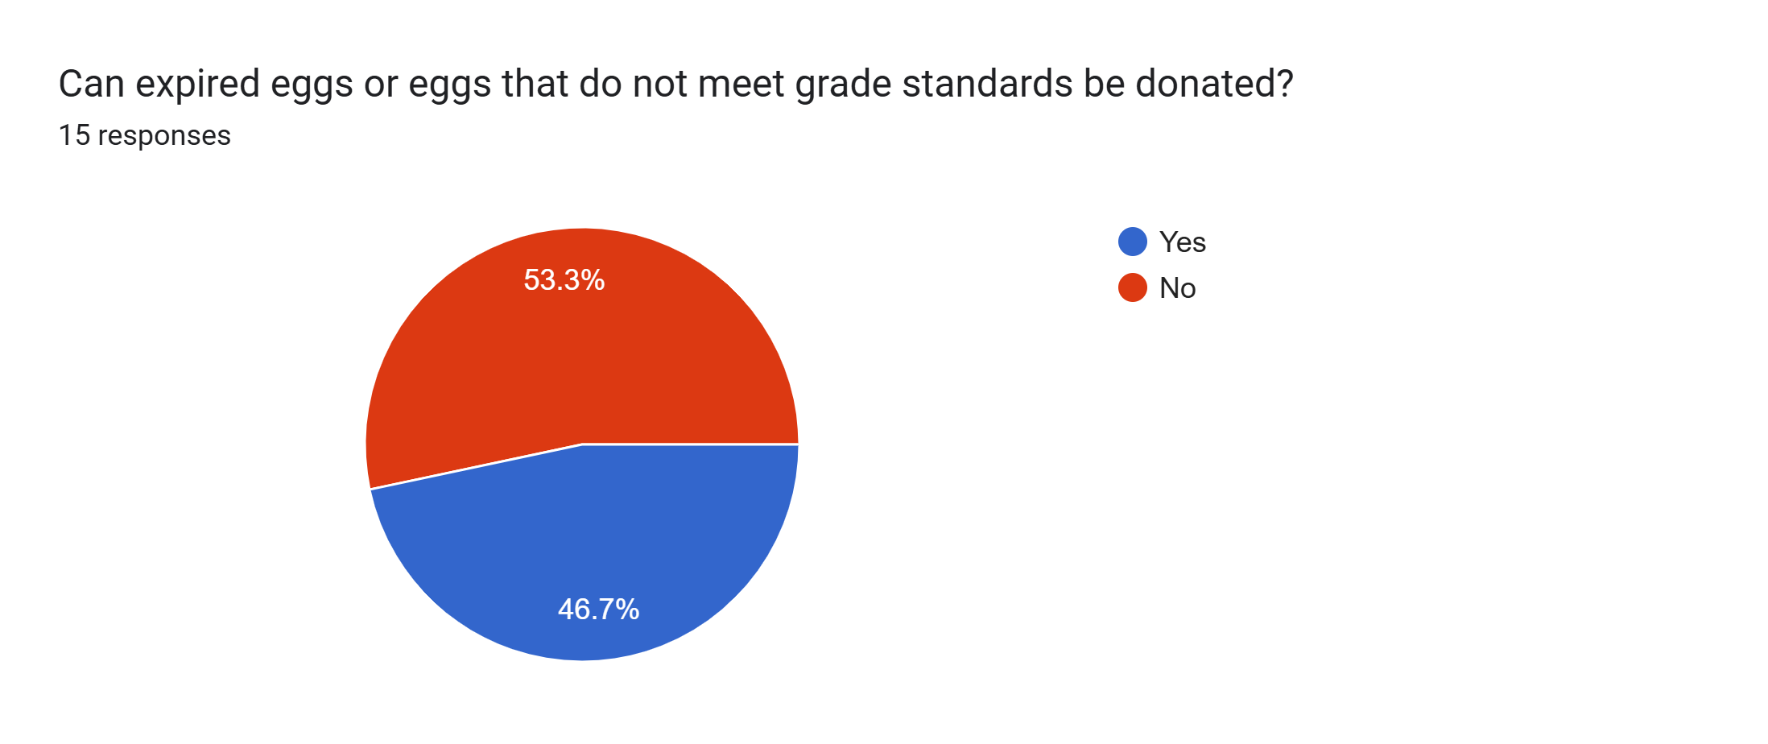
Michigan, Arkansas, Arizona, Minnesota, California, Wisconsin, Indiana

Slide 24
Egg Traceability
Summary Sheet

Slide 25
Other Comments or issues for states?
California created AB660 regarding not using "sell by date" however, eggs are exempt
We would like to see a discussion on the application of USDA grade standards. Example: should a mixed rot tie up a full lot? Should the allowance for dirt/loss/leaker be split and consider leakers differently? What is a dirt (specks vs globs)?
A governor's executive order is mandating that we do a program accountability study to maintain Administrative rules. It includes a program functions and cost comparison to adjoining states and any other state the Office of Management and Budget deems necessary.
We have pending legislation on Home Based Businesses/Cottage Foods that allows TTC foods to be sold unregulated. Up to $1.5 million per year per business in gross sales. Eggs other than domestic chicken are included.

Slide 26
Other Comments or issues for states?
We would like to see a discussion on the application of USDA grade standards. Example: should a mixed rot tie up a full lot? Should the allowance for dirt/loss/leaker be split and consider leakers differently? What is a dirt (specks vs globs)?
A governor's executive order is mandating that we do a program accountability study to maintain Administrative rules. It includes a program functions and cost comparison to adjoining states and any other state the Office of Management and Budget deems necessary.
We have pending legislation on Home Based Businesses/Cottage Foods that allows TTC foods to be sold unregulated. Up to $1.5 million per year per business in gross sales. Eggs other than domestic chicken are included.

Slide 27
NERO ROLL CALL
Miramar Beach, FL
NERO Board: 3/2/2025

